Slide 1

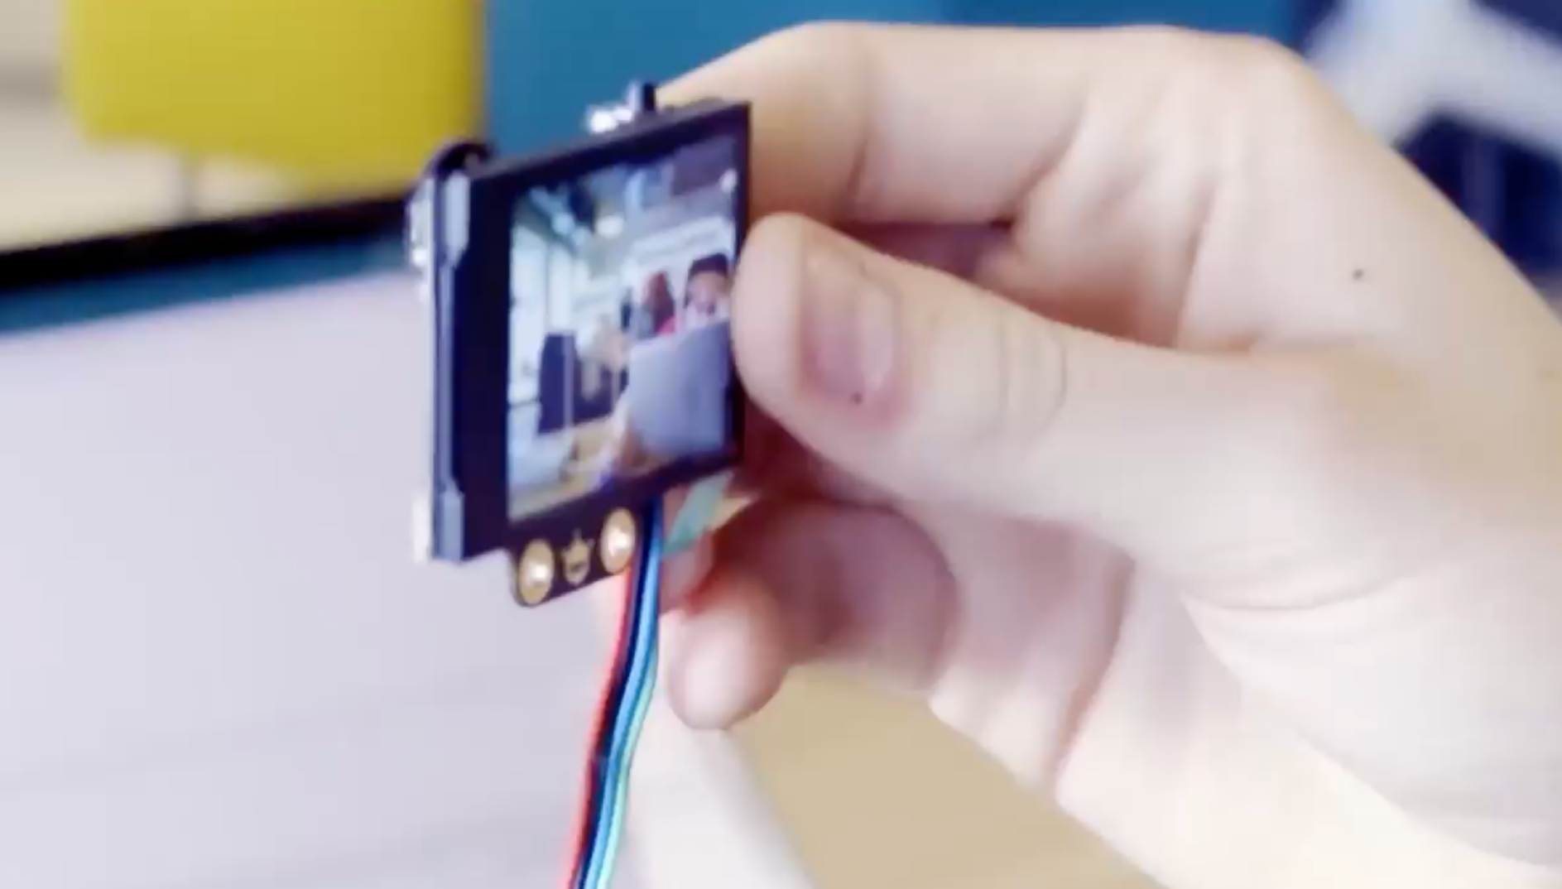
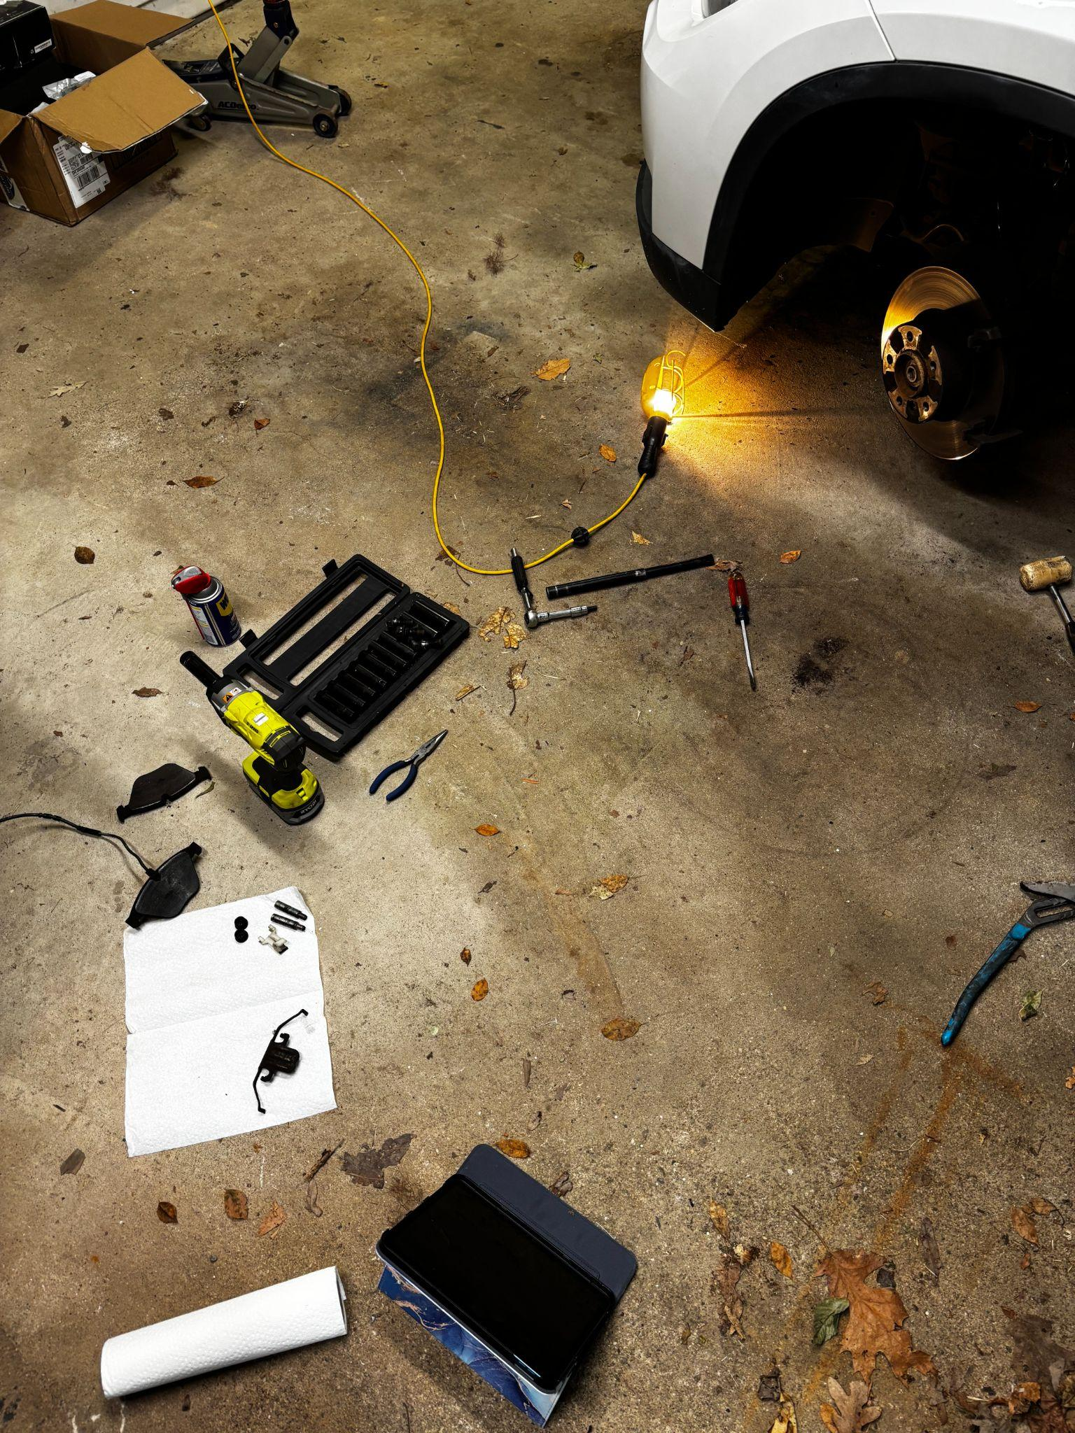
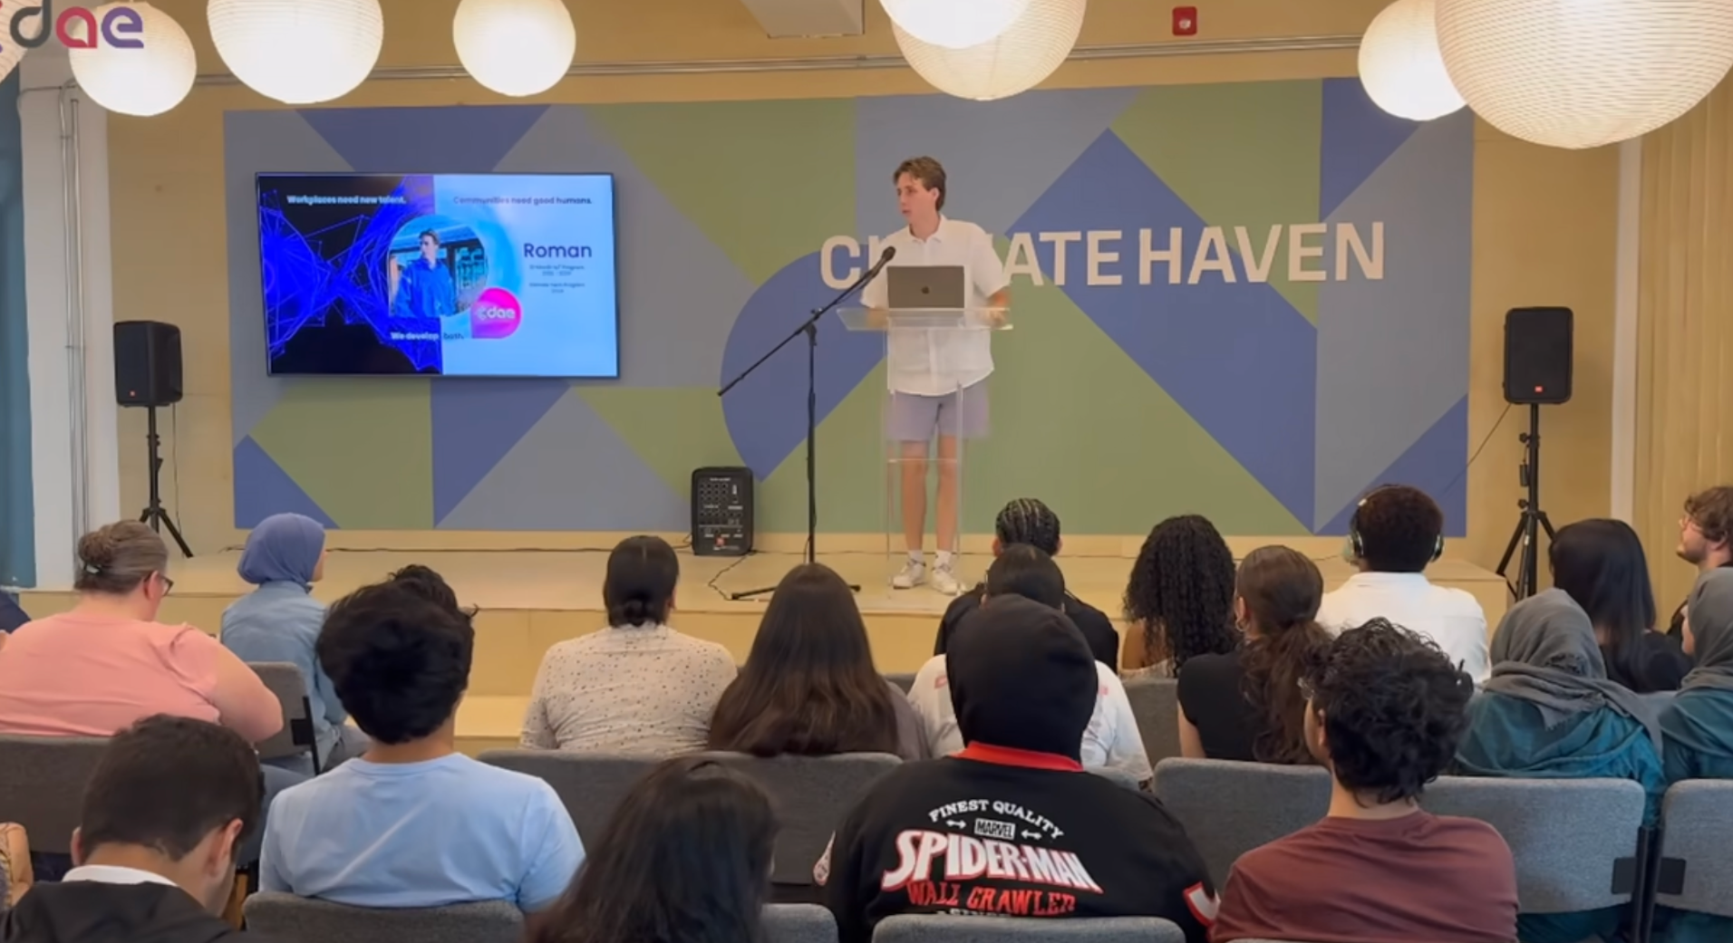
Who am I?

Slide 2
During this 6 month program I hope to be able to gain the technical and soft skills required to succeed in a company.
0-2 Years
2-5 Years
5+
Start an entry level cyber security job with the same interests and values as me.
Contribute new ideas and work on experimental/new ideas in the workplace.
Lead teams and projects in a collaborative and passionate organization.

Slide 3


Cybersecurity
Collaborative and social
Dynamic problem solving work
Understanding of networks

Slide 4

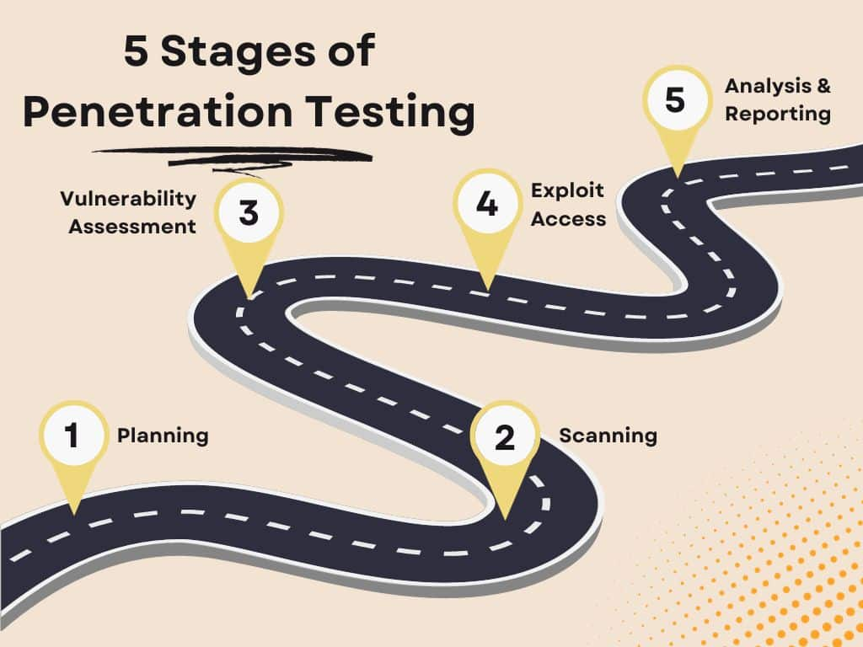
All in one CLI pentesting tool
My project is a pentesting tool designed to group all the steps of the pestesting process together. In doing so this removes the need for repetitive work and lowers testing time.

Slide 5
Thank you.

